Slide 1

Misuse of Computers
ICT and the Law

Slide 2
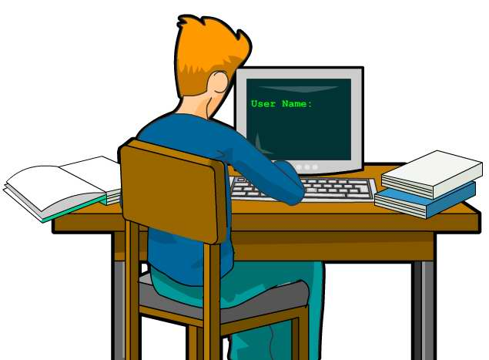
For all sorts of reasons, some people try to access computer material they are not authorized to.
I wonder if I could get in…

Slide 3
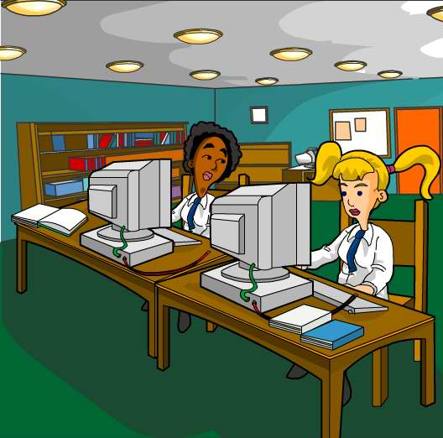
If I could get into her file I could copy her coursework…

Slide 4
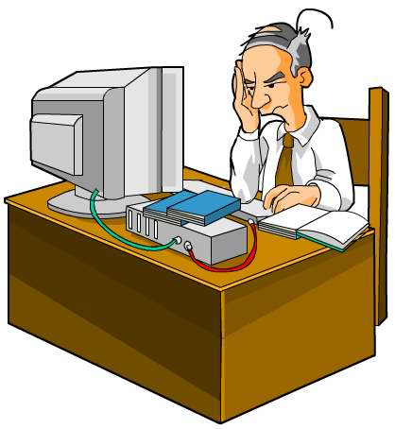
I wish I could see our competitor’s designs!

Slide 5
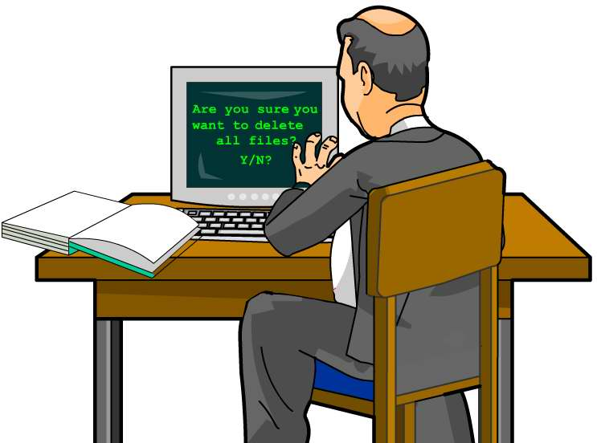
I’ll teach them to sack me!

Slide 6
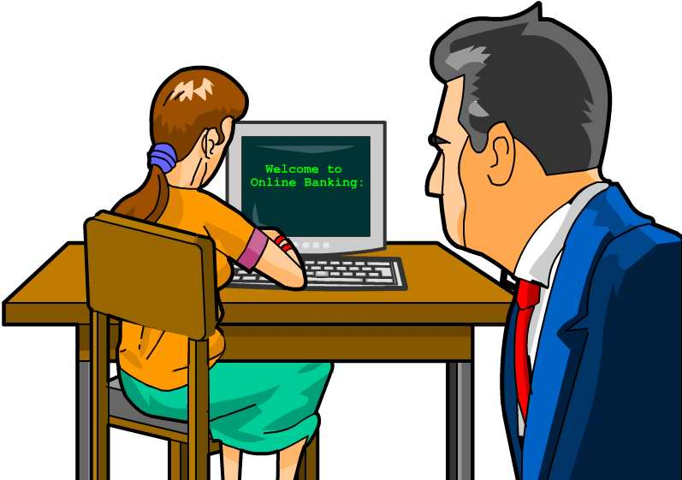
I want some of her money!
That’s why we need a Computer Misuse Act.

Slide 7
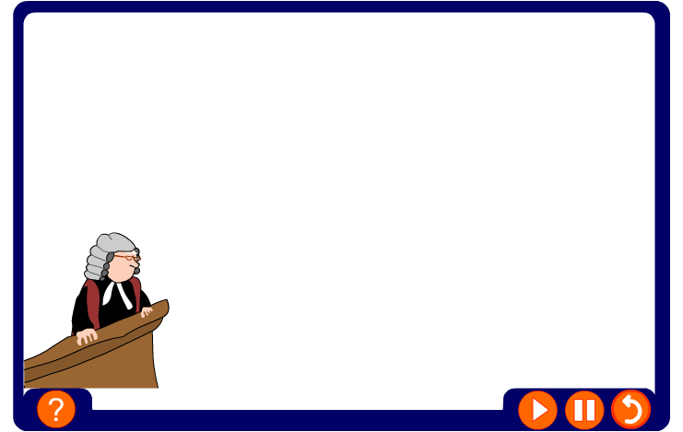
Computer Misuse Act
The Computer Misuse Act was passed to stop unauthorized access to computers, often called hacking. There are three offences in the act.

Slide 8
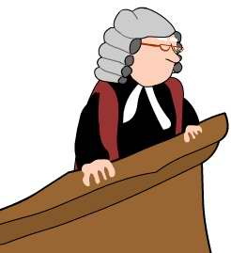
1. Unauthorized access to computer material is an offence.
2. Accessing with intent to commit or facilitate committing another offence.
3. Unauthorized modification to computer material.
That’s bad.
That’s worse.
That’s the worst!

Slide 9
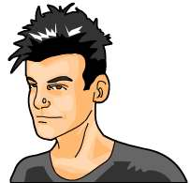
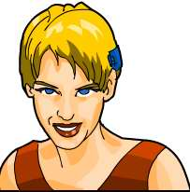
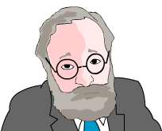
Hackers
Many people think of hackers as glamorous teenage whizz kids who know lots about computers.
The image of a hacker is often stereotypical but in reality may be system administrators, business rivals, thieves, foreign security services or disgruntled employees.
Hackers may not mean to damage anything, but they might do so by accident.
Who is the hacker?
It could be any one of them!

Slide 10
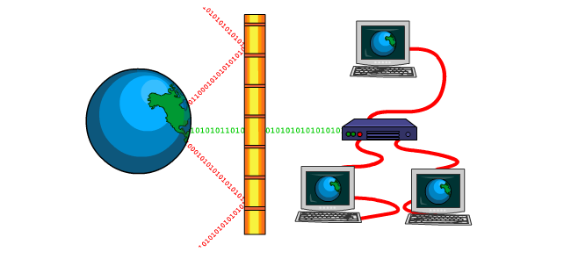
Firewalls
A firewall can stop others from hacking into your computer. This is a program which filters data coming in through the Internet to a computer or network.
It stops people hacking into your system, taking control of your computer and using your machine as a host to access or run programs.

Slide 11
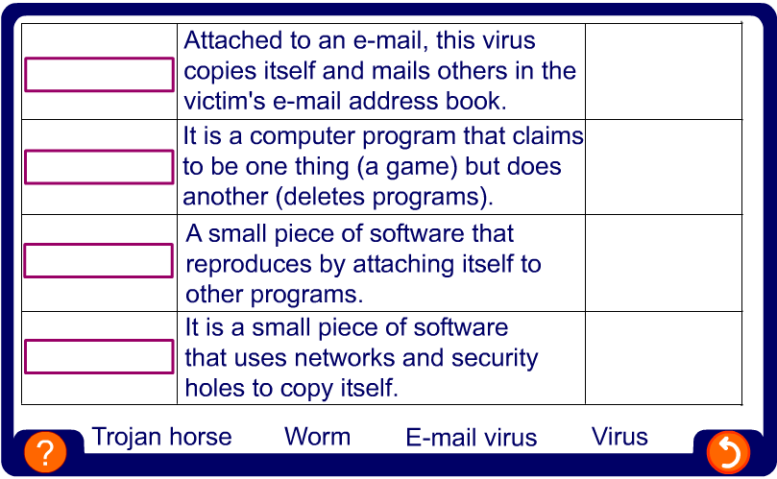
Electronic infections
The most common types of electronic infection are: virus, e-mail virus, worm and Trojan horse.

Slide 12
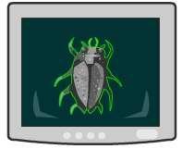
Computer viruses
A virus is a piece of computer code which copies itself, usually without your permission.
Some viruses can damage data. All viruses use up system resources (memory, hard disk space, etc.).
Viruses are written by people, they don't just appear. On many occasions they are sent as attachments to e-mails.
Because viruses cause computer code to be modified (changed), they are illegal under the Computer Misuse Act.
The first British virus writer to be prosecuted, in 1995, was sentenced to 18 months in prison.

Slide 13

Preventing infections
Install anti-virus software and ensure it is updated regularly.
Avoid downloading programs from unknown sources.
Never run macros in programs unless you know what they are.
Never open an e-mail attachment if it is not from someone you know.

Slide 14
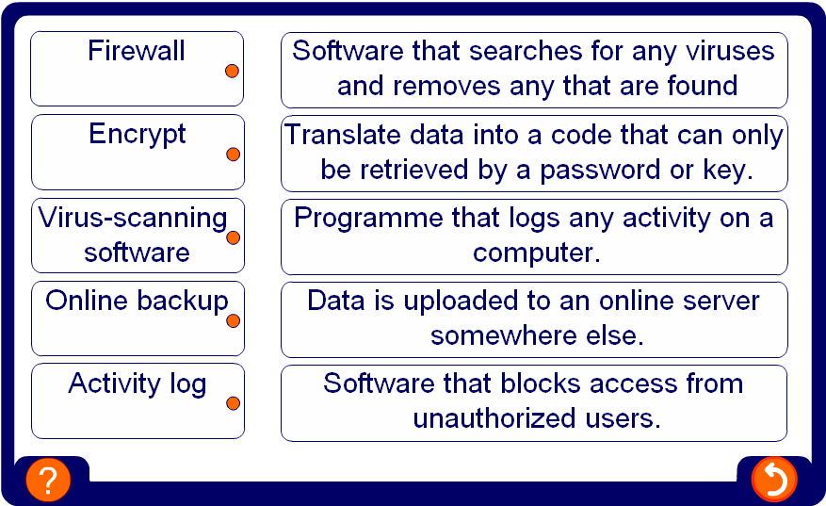
Keeping data safe

Slide 15

Summary
The Computer Misuse Act was passed in 1990.
It is designed to stop unauthorized access.
Hackers attempt to take control by viewing, accessing or running programs from another person’s computer without their permission.
A firewall stops other users from hacking into your computer by filtering data coming in through the Internet to a computer or network.
A virus, e-mail virus, worm and Trojan horse are all types of electronic infections.
Anti-virus software prevents infections, providing it is regularly updated.

